Slide 1
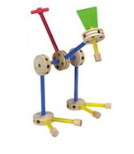
Afternoon Slides Boot Camp for Digital Systems Education Running generated RTL thru Vivado
Jim Brakefield jim.brakefield@ieee.org
IEEE Computer Society
Notes:
Tinker toy construction embodies the generation/design of objects from simple uniform components

Slide 2
Preliminaries
Classroom provided by St. Mary’s University
Funding provided by a grant from the IEEE Computer Society as part of their Emerging Technologies program
I’m Jim Brakefield, jim.brakefield@ieee.org
Full set of files (20MB) at:
https://github.com/jimbrake/FPGA_Boot_Camp
Introduction to FPGA video: https://www.youtube.com/watch?v=EVy4KEj9kZg

Slide 3
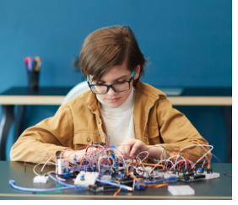
mess of wires not cool any more
In today’s world
most wires are
in the PCB and
In the FPGA !
OK as long as you
don’t need to
move the device
From https://life.ieee.org/
Notes:
For more organized and stable proto-board wiring see a Ben Eater's web page: https://www.reddit.com/r/beneater/comments/w447u3/created_a_random_maze_program_for_my_putey1_ttl/

Slide 4
My view of binary
Zero and ones: One names a single such signal or a group of such signals (subscripted by bit number)
A binary number is a polynomial:
A[n-1]x^{n-1} + A[n-2]x^{n-2} + … A[1]x¹ + A[0]x⁰
Where X = 2, and A[n] are 0 or 1 bits from the number. If A[n-1] is 0/-1 then it is 2’s complement and negative if A[n-1] is -1.
It is typical for the bit numbers to run from N-1 to 0 where N is the number of bits.
Adding or subtracting 2’s complement wraps around in a circle where the most positive and most negative numbers are adjacent (any carry or borrow beyond x^{n-1} is discarded).
Windows calculator has binary features: https://www.youtube.com/watch?v=PK5WQqN3_44
Notes:
The youtube video covers all the calculator features including radix (binary, hex, decimal) and the binary operations (AND, OR, XOR, shifts and rotate).

Slide 5
This afternoon’s agenda
What’s on the FPGA board
FPGA parts (LUTs, Block RAM, DSP, IO, fabric)
Review of digital logic & binary
Summary of VHDL/Verilog
Summary of constraint files
Do a Vivado project

Slide 6
This afternoon’s agenda
Who hasn’t got Vivado installed?
Have a disk drive & flash drive with install files
Will take 30+minutes
Who hasn’t generated VHDL or Verilog from their schematic?
A picture of everyone with their FPGA board

Slide 7
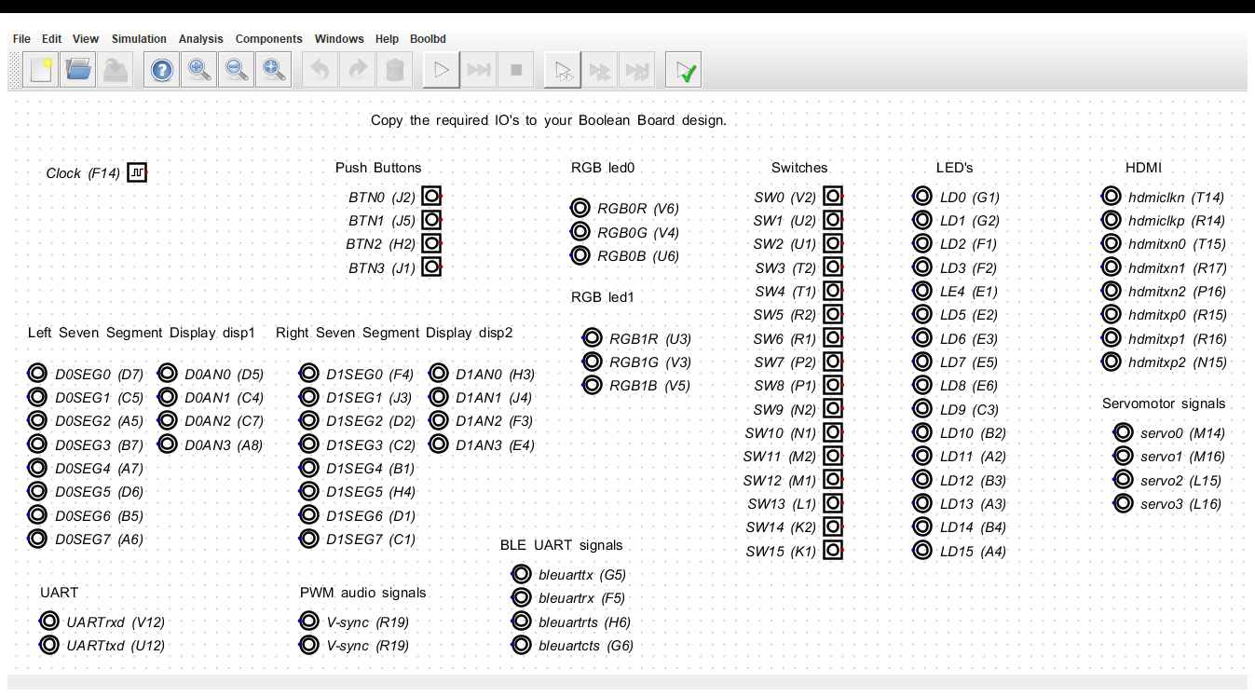
Boolean Board IOs Boolbd_IOs.dig
https://github.com/jimbrake/FPGA_Boot_Camp

Slide 8
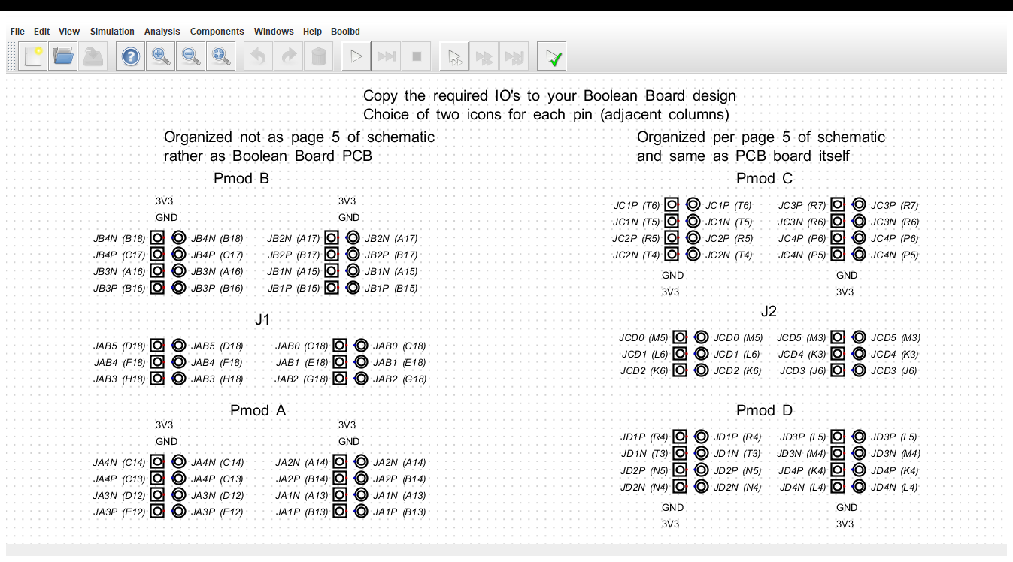
Boolean Board Pmod IOs Boolbd_Pmods_PCB_view.dig
https://github.com/jimbrake/FPGA_Boot_Camp

Slide 9
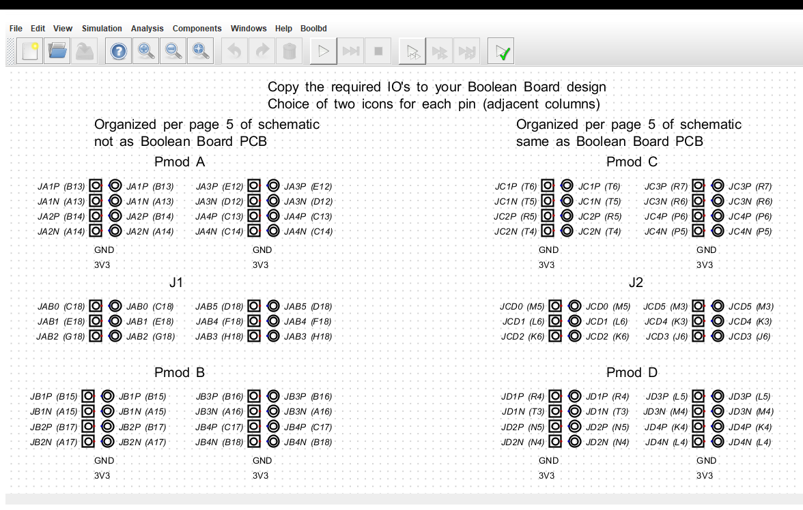
Boolean Board Pmod IOs Boolbd_Pmods_schematic_view.dig
https://github.com/jimbrake/FPGA_Boot_Camp

Slide 10
RTL (Register Transfer Language) VHDL and Verilog are “hardware description” languages
Separates design into combinatorial (logic) and sequential (registers).
For simple designs use a single clock
Boolean Board clock input is 100MHz
Digital will generate slower clocks
Right click on clock icon & set frequency
Registers update on rising edge clock
Notes:
This FPGA Boot Camp avoids teaching VHDL or Verilog, instead you learn by seeing the VHDL or Verilog generated from your schematic. This is done to get to a working “ FPGA flow” more easily.

Slide 11
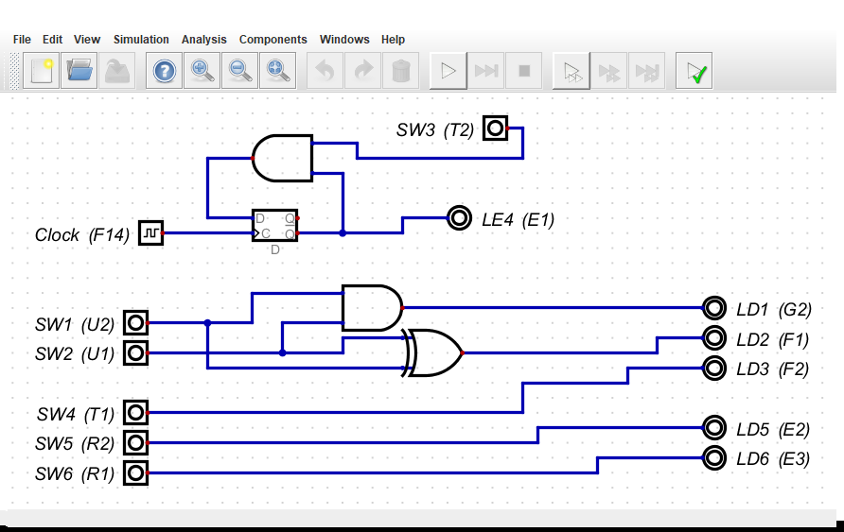
Schematic for project
fresh_start.dig schematic
Notes:
Boolean Board clock is 100MHz. Here the clock (via right click) is set to 1Hz. Digital generates a clock divider that divides 100MHz by 50 million.

Slide 12
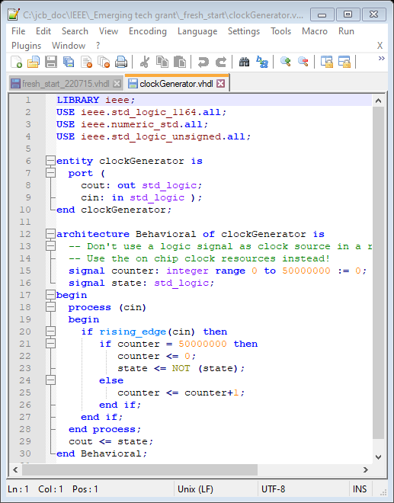
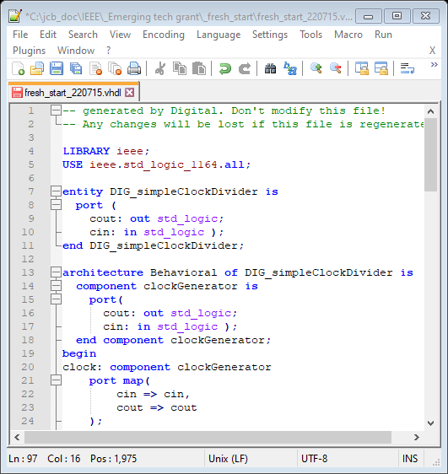
fresh_start VHDL part 1
Notes:
On the left the VHDL interface to clockGenerator.vhdl. On the right the clockGenerator.vhdl file.

Slide 13
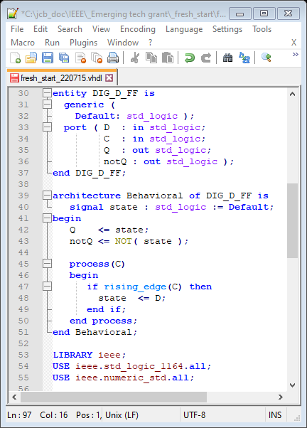
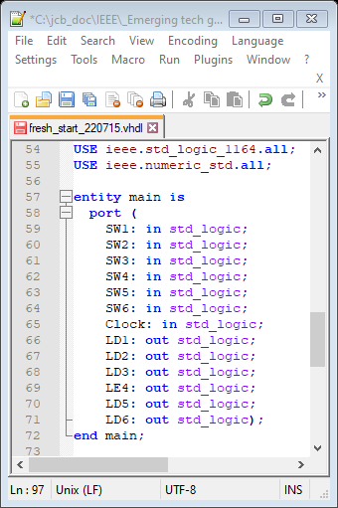
fresh_start VHDL part 2
Notes:
On the left the description of a D flip-flop. On the right the VHDL interface to the Boolean Board signals in use.

Slide 14
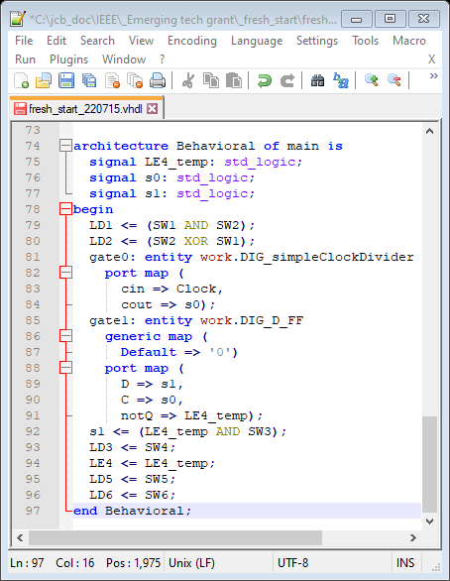
fresh_start VHDL part 3
Notes:
The entire description of the circuitry associated with the schematic. Including a port map of the clock divider.

Slide 15
Side by side VHDL and Verilog
Digital generates both
RealDigital’s treatment:
https://www.realdigital.org/downloads/e06bddc63669cbc91ae981df18bcf3c5.pdf
Side by side System-Verilog & VHDL:
Digital Design and Computer Architecture, Harris & Harris, 2nd ed. Also ARM and RISC-V editions
Highly recommended, goes from transistors to PCs
Side by side Verilog & VHDL:
HDL Programming Fundamentals: VHDL and Verilog, Nazeih Botros 2006
Also: https://www.fpga4student.com/2017/08/verilog-vs-vhdl-explain-by-example.html
Notes:
System Verilog is a modern version of Verilog and provides the same capabilities as VHDL.

Slide 16
Side by side VHDL and Verilog cont’d
Clive “Max” Maxfield’s books:
The Design Warrior's Guide to FPGAs, 2004
FPGAs: World Class Designs, 2009
Electrical Engineering: Know It All, 2011
covers the entire electronics field
chapters are written mostly by others
Max writes columns for
https://www.eejournal.com/

Slide 17

Basic Digital tutorials https://www.realdigital.org/hardware/boolean

Slide 18
What FPGA tools do
Much goes on behind the scenes
Circuit is optimized (logic simplification)
unused stuff is pruned, if no outputs then all pruned
Circuit is mapped into FPGA primitives
Circuit wired up with FPGA routing resources
Bit file generated that configures the chip
Error checking especially missing semicolons
Reports on timing, resources used, error messages
A schematic viewer will show chip details
Elaborated Design show’s vivado’s version of schematic

Slide 19
LUTs
Performing Boolean Algebra inside an FPGA using Look-Up Tables (LUTs)
https://nandland.com/lesson-4-what-is-a-look-up-table-lut/:
Note to the reader: many textbooks and classrooms will spend a
significant amount of time discussing how LUTs can be wired to
create the optimal solution to a Boolean expression. Optimal
means that it uses the least number of gates possible. Topics
such as De Morgan’s Law, Karnaugh Maps, the Quine-McCluskey
method, and others are usually discussed at great length that
describe how to optimize digital logic. However I feel that this is
not necessary to begin learning about FPGAs.

Slide 20
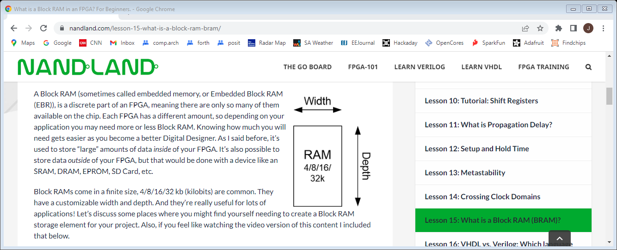
Block RAM tutorial
https://nandland.com/lesson-15-what-is-a-block-ram-bram/

Slide 21
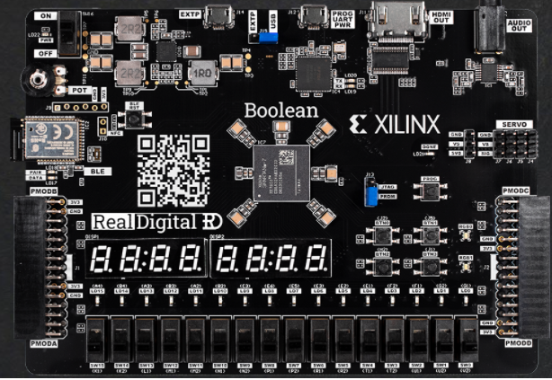
Boolean board $69/$79
Notes:
Uses AMD/xilinx tools(vivado). The staggered IO holes is deliberate, will hold and connect headers without soldering. HDMI video out. Available with or without Bluetooth LE. Digital schematic tool: Three *.dig files: base IO, Pmod schematic view, Pmod PCB view (recommended).

Slide 22
Boolean Board background
RealDigital.org
Educational mission
Very well done courseware, uses hyper links
Have added additional boards to their web site
Some that are very advanced!
Board uses AMD/xilinx Spartan-7 FPGA
Full part number: XC7S50-CSGA324
50K logic cells (33K 6-LUTs)
2.8M bits of block RAM (300K bytes)
One of the least expensive FPGA boards with full user IO, also servo headers & potentiometer
Notes:
If time & budget allows will do the course with the DE10-Lite board (in the fall).

Slide 23
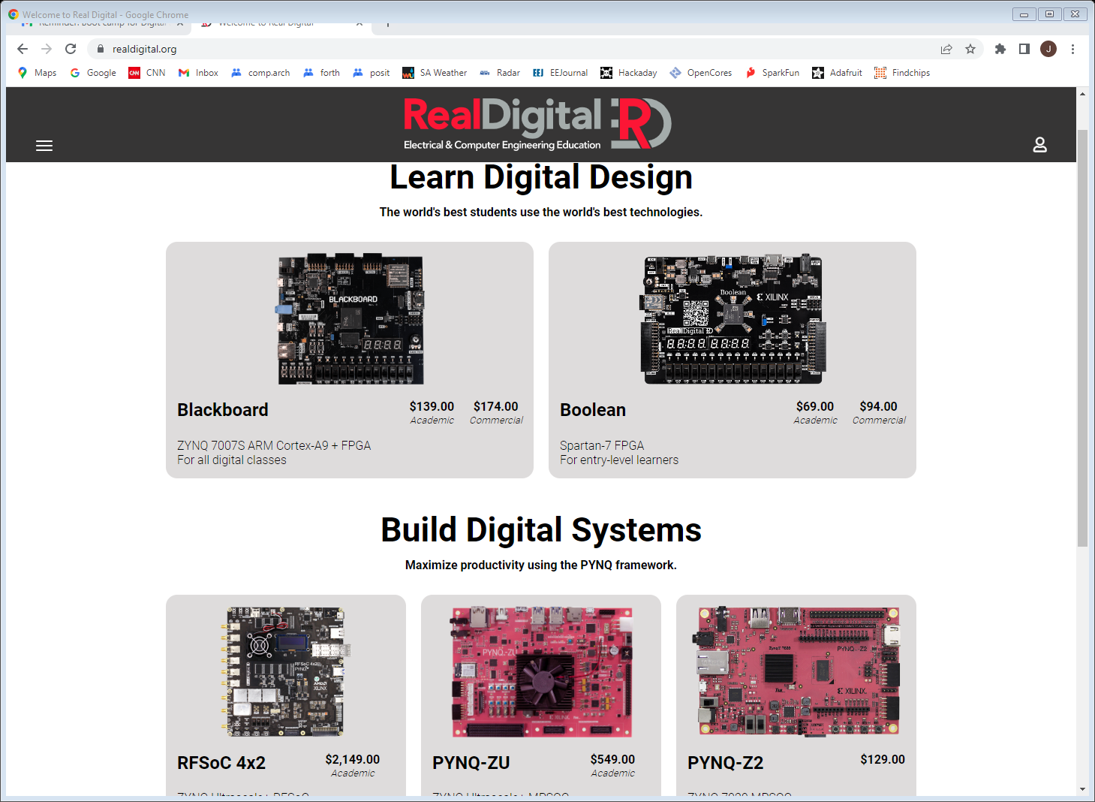
RealDigital.org
Notes:
Recently added the three boards at the bottom row.

Slide 24
Downloading vivado
https://www.xilinx.com/support/download.html
https://www.xilinx.com/support/installer/installer-info-general.html
Use the web installer (212MB) and only install vivado and Spartan-7 devices. Full install is a 89GB tar.gz file!!
Will still take time: 12GB download!
Takes 40GB of disk space!! ☹
Follow RealDigital Boolean Board instructions at https://www.realdigital.org/doc/1fd3322461ac4bcc1fcd6bcc6c5907ec
Can add additional FPGA devices later
Hundreds of video tutorials (use help button)
Notes:
Took 3 hours total at 100Mb/sec download speed. Did not turn off anti-virus protection.

Slide 25
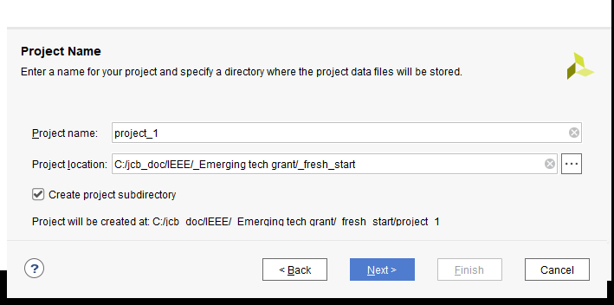
Creating a Vivado project
Double click Vivado 2022.1 icon
File/Project/New/Next

Slide 26
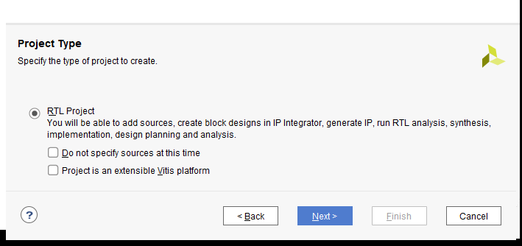
Creating a Vivado project step 2
Project Type: RTL
Add Sources: Next

Slide 27
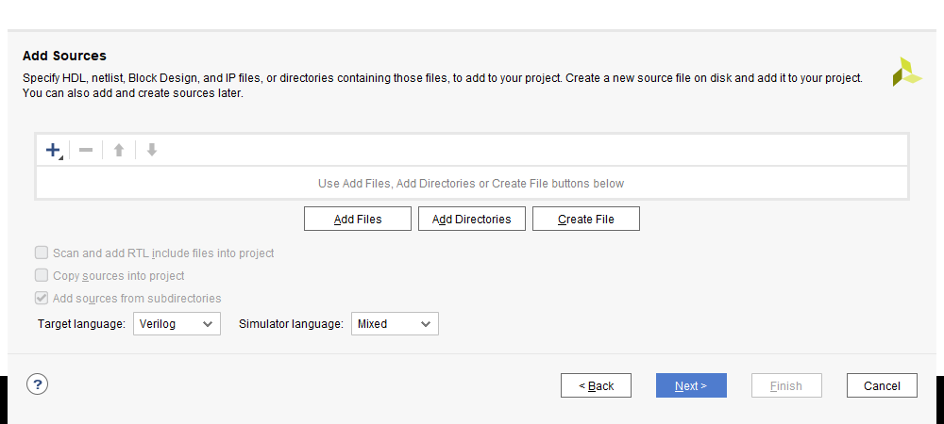
Creating a Vivado project step 3
Add Sources: Add Files

Slide 28
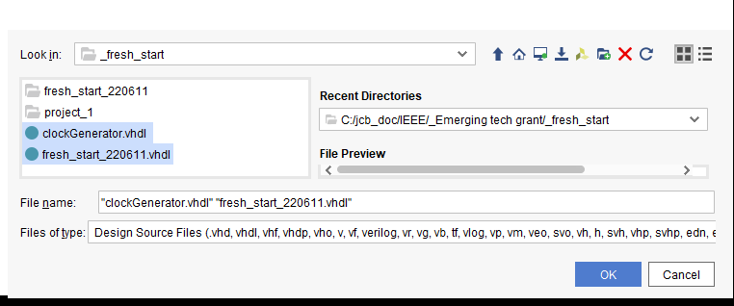
Creating a Vivado project step 4
Pick VHDL or Verilog files from your directory
Next (will copy & add files to project)

Slide 29
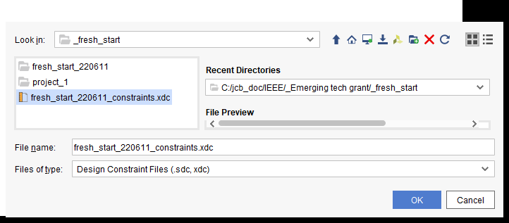
Creating a Vivado project step 5
Add constraint file

Slide 30
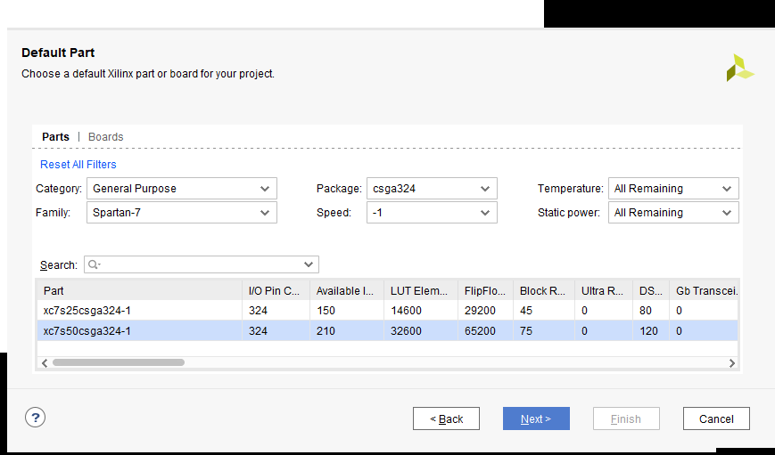
Creating a Vivado project step 6
Need to get this exactly right
Notes:
Full part number: XC7S50-CSGA324

Slide 31
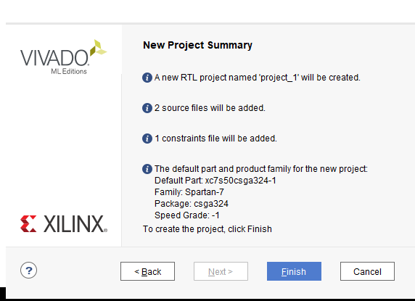
Creating a Vivado project step 7
Finish

Slide 32
Creating a Vivado project step 8
Generate Bitstream will do the following:
RTL ANALYSIS (checks for errors)
SYNTHESIS (maps RTL to FPGA primitives)
IMPLEMENTATION (wires up the primitives)
PROGRAM AND DEBUG (simulation is key)
And report any errors
Digital generated RTL should not have errors!

Slide 33
Creating a Vivado project step 9
After several minutes and no errors
Check Utilization, I prefer “Table”
LUT count, DFF count, etc.
IO should match your design
BUFG is for the clock input
Post Synthesis is an initial estimate
Post Implementation is final usage
For a simple design Power is < 0.1 Watt
Vivado: Flow/Open Elaborated Design

Slide 34
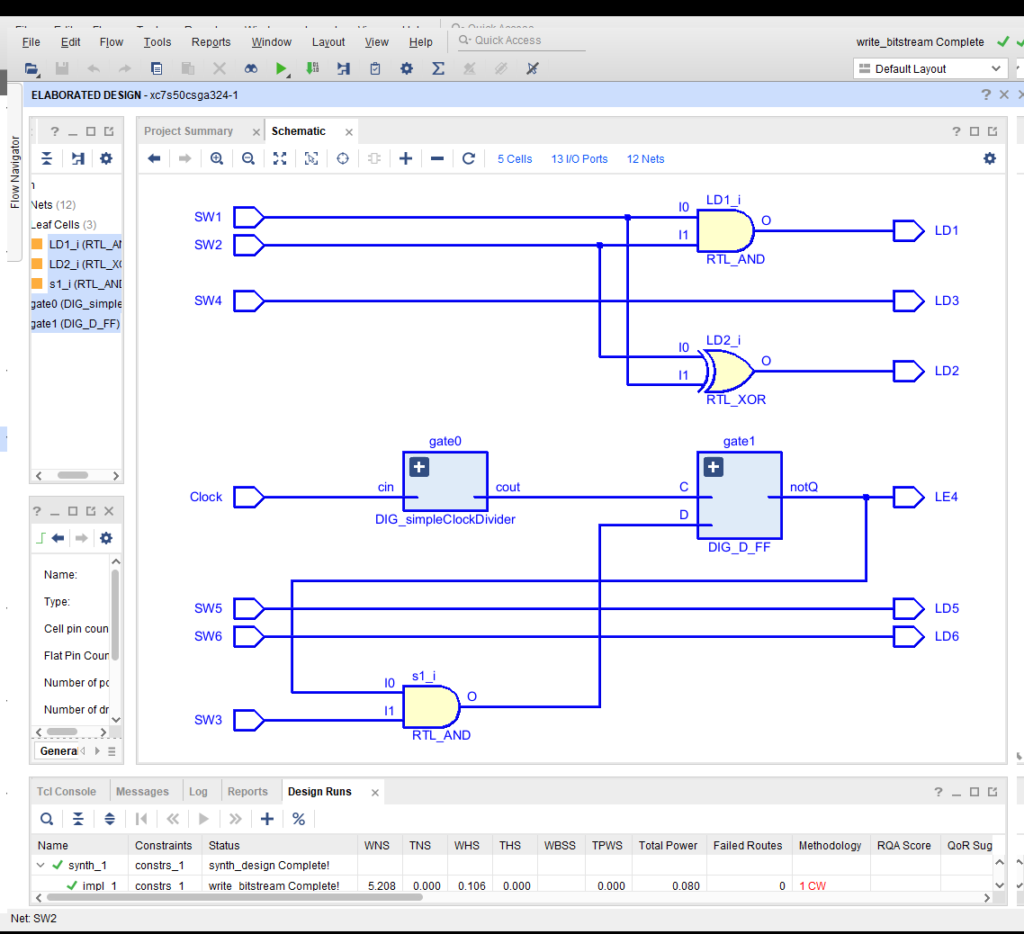
Elaborated fresh_start design
Notes:
Vivado’s schematic of the fresh-start design, use to compare with the Digital schematic and its RTL (used ctrl A & ctrl B for bolding)

Slide 35
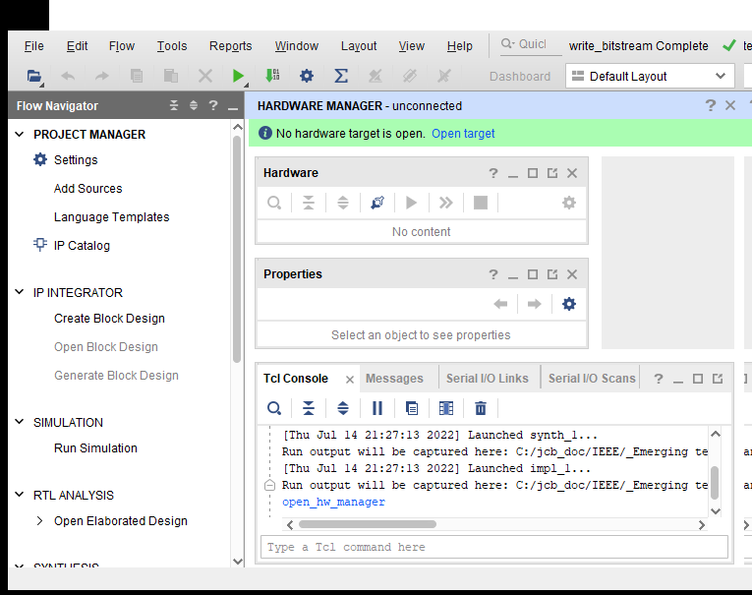
Creating a Vivado project step 10
Open Hardware Manager (board plugged in and turned on)

Slide 36
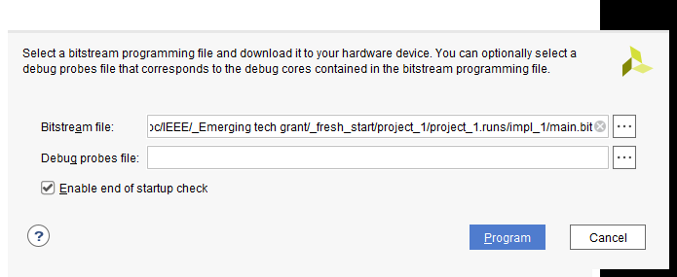
Creating a Vivado project step 11
Open Target – Auto Connect – Program device
Turn switch 3 on
LED 4 will blink every two seconds
Other switches control other LEDs
Success!

Slide 37
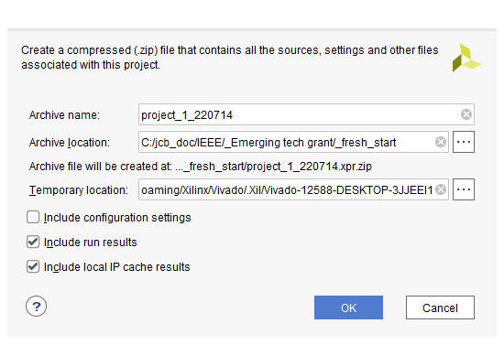
Archive Project
File/Project/Archive
Creates zip file of 779KB, full project is 3.5MB
Programming file: Main.bit (2,141KB) is compressed!

Slide 38
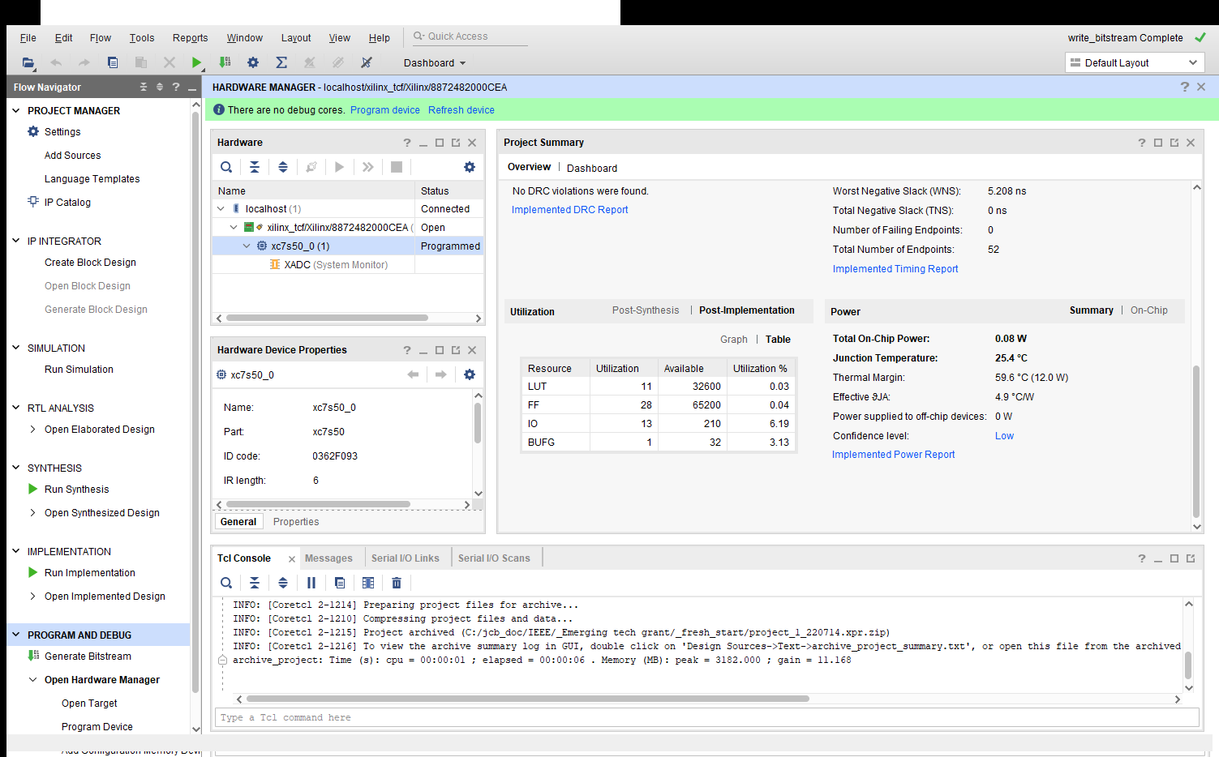
Vivado project summary

Slide 39
FPGA References
Twelve youtube videos on specific FPGA features (uses verilog RTL): https://www.youtube.com/playlist?list=PLEBQazB0HUyT1WmMONxRZn9NmQ_9CIKhb
Three Ages of FPGAs: A Retrospective…, Steve Trimberger, Proc. IEEE v103#3p318, 2015
www.cpe.virginia.edu/grads/pdfs/January%202016/VLSI.pdf
https://www.youtube.com/watch?v=4ntXSyOhlBY
Xilinx Part Family History, John Lazzaro,
www-inst.eecs.berkeley.edu/~cs294-59/fa10/resources/Xilinx-history/Xilinx-history.html
Altera History, corporate, http://www.fundinguniverse.com/company-histories/altera-corporation-history/
Low cost FPGA boards
https://www.joelw.id.au/FPGA/CheapFPGADevelopmentBoards
Open source IP https://opencores.org/projects
Github projects: search on “github vhdl verilog cpu”
Notes:
http://www.fundinguniverse.com/company-histories has histories of Xilinx and many other companies

Slide 40
Not quite free
Using the grant money to buy an FPGA board for each student (and lunch), the idea being that way each student can spend more time on the board.
In return for the “free” FPGA board, you e-mail a progress report periodically to jim.brakefield@ieee.org
Part of the grant is to determine the viability of this approach to FPGA/Digital System education, hence need feedback.

Slide 41
In conclusion
It is thought that ownership of an FPGA board will lead to greater usage and knowledge. As opposed to shared laboratory equipment.
Oriented towards a beginner’s board at low cost. Lots of switches, LEDs etc. eliminate need for discrete components and their fragile wiring.
Future class dates and registration links at:
TBD
Notes:
Files at https://github.com/jimbrake/FPGA_Boot_Camp have a date code suffix and are updated frequently. Currently several universities issue an FPGA board to each student for a one semester course.

Slide 42
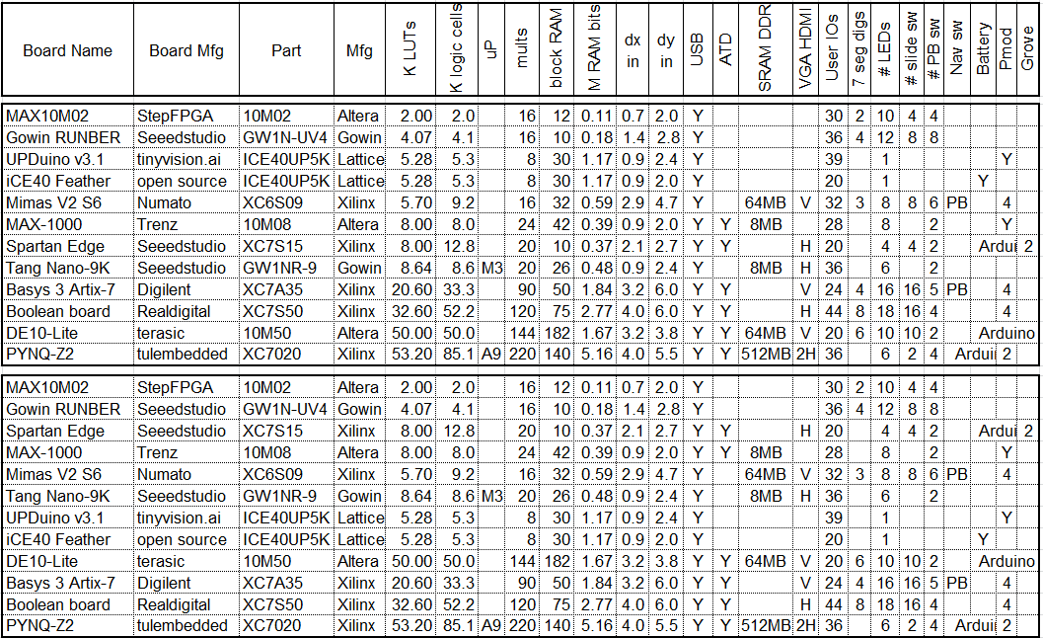
FPGA board rankings
Top version sorted by LUT count, bottom version by block RAM bit count
This listing is only a sample of the hundreds of boards available.
10/21/2022
10/21/2022
42
42

Slide 43
Educational programs
Intel/Altera academy Quartus: RTL & Schematic
AMD/Xilinx university program ISE & Vivado RTL tools
Courseware for Real Digital Boolean board RTL
https://www.realdigital.org/course/digital-logic-for-the-boolean-board
https://www.tina.com/ (Schematic based, not free)
Support for the Digilent Basys 3 and the Terasic DE10-Lite FPGA boards
https://www.tina.com/blog/programming-fpga-boards-with-tina-using-schematic-design-entry/
Digital logic designer & simulator (Schematic based, free)
Support for the Boolean Board, Digilent Basys 3 & TinyFPGA-BX boards
https://github.com/hneemann/Digital/
Notes:
RTL: Register transfer language, usually VHDL or Verilog. Quartus and Vivado are mainstream tools with free education variants (reduced FPGA family support). Xilinx ISE not recommended for new users.

Slide 44
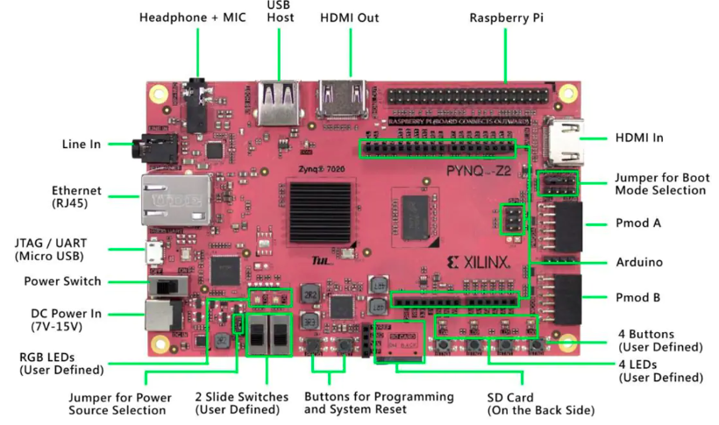
PYNQ-Z2 $123 at Newark (for the more advanced user)
FPGA boards with microprocessor cores typically use serial terminal
for user IO and thus fewer switches, buttons & LEDs needed
Notes:
FPGA board with two ARM A9 cores. Available at RealDigital and Newark. See http://www.pynq.io for it’s software infrastructure!

Slide 45
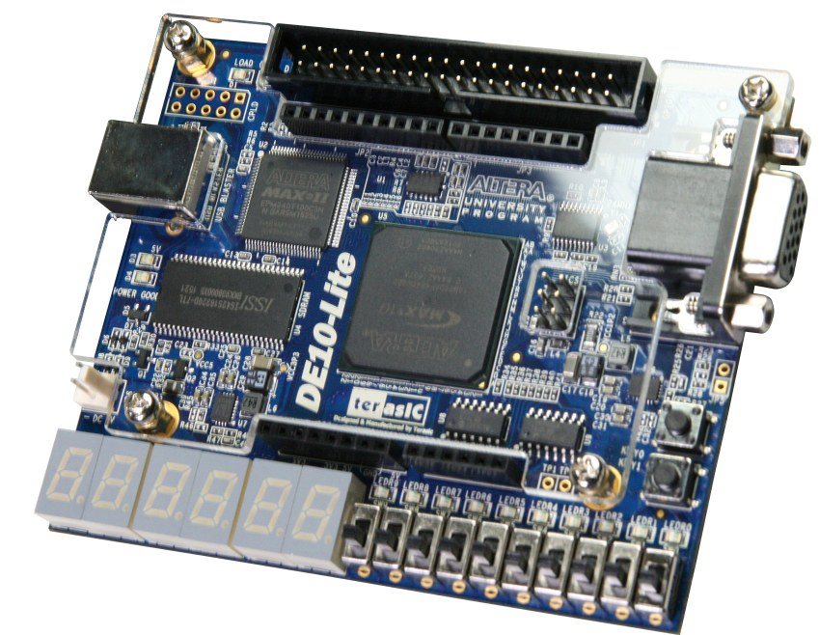
Intel/Altera academic program
https://www.intel.com/content/www/us/en/developer/topic-technology/fpga-academic/overview.html
https://www.intel.com/content/www/us/en/developer/topic-technology/fpga-academic/materials.html
https://fpgacademy.org/tools.html
DE10-Lite academic price $77
Notes:
Only two push buttons. Least expensive Altera board with “full” user IO. Arduino headers and DRAM.

Slide 46
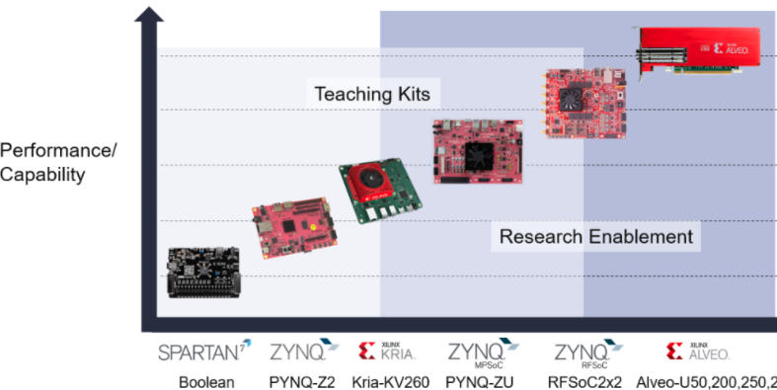
Xilinx university program
https://www.xilinx.com/support/university.html
https://www.xilinx.com/support/university/boards-portfolio/xup-boards/RealDigitalBoolenBoard.html
$69 $123 $200
$549
$2149
Notes:
Boolean Board “endorsement” by Xilinx. Kria-KV260 has state-of-the-art FPGA, heavily backordered, 16 week lead time.

Slide 47
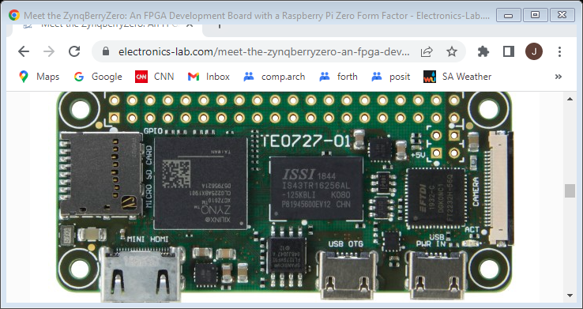
ZynqBerryZero $120
https://www.electronics-lab.com/meet-the-zynqberryzero-an-fpga-
development-board-with-a-raspberry-pi-zero-form-factor/
512MB DDR3, 3x6.5mm, camera conn, mini-hdmi, micro SD slot
Notes:
Single ARM core. Trenz web page:
https://shop.trenz-electronic.de/en/TE0727-02-41C34-ZynqBerryZero-Module-with-Xilinx-Zynq-7010-512-MB-DDR3L-SDRAM-3-x-6.5-cm Not in stock.

Slide 48
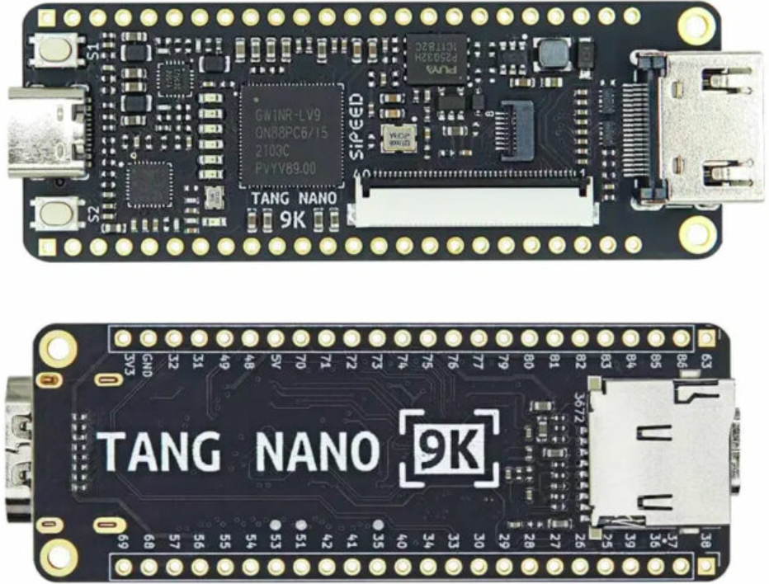
Lowest cost with ARM M0 $15
10/21/2022
48
Notes:
Uses Gowin GW1NR-9 FPGA: ARM Cortex M3, 8K LUTs, 2 push buttons, 6 LEDs, HDMI connector, SD slot, DRAM, LCD connector

Slide 49
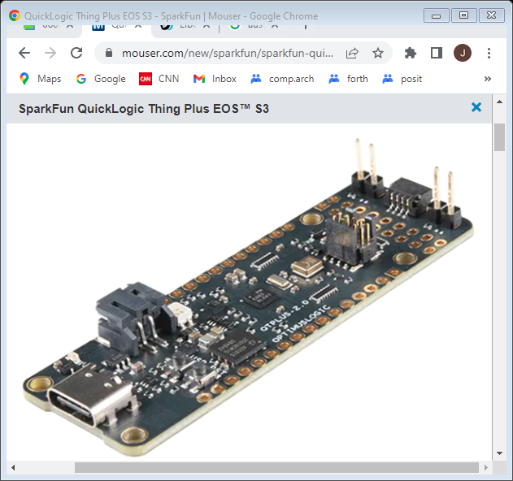
QuickLogic Thing Plus EOS™ S3
Notes:
In stock at Mouser, ARM Cortex-M4F, uses wide tiles = ~2.4K 4LUTS. Lithium battery support (Feather form factor).

Slide 50
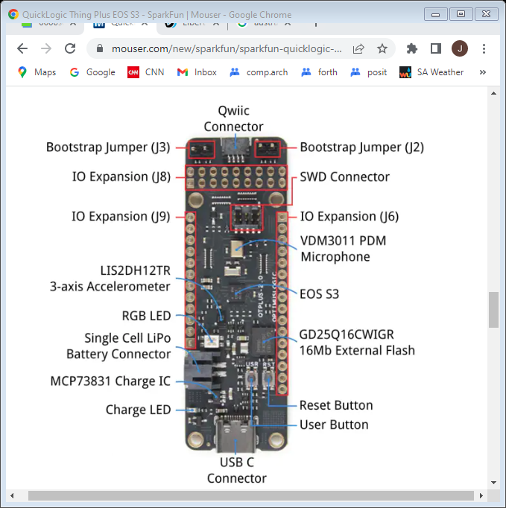
QuickLogic Thing Plus EOS™ S3 $48
Notes:
In stock at Mouser, ARM Cortex-M4F, uses wide tiles = ~2.4K 4LUTS. Lithium battery support (Feather form factor).

